Slide 1

Canadian Election Analysis
Group Members:
Noah David - C846073
Akash Guje - C0835384
Jebin George - C0850509

Slide 2

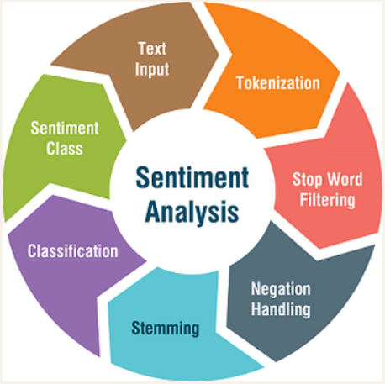
Introduction:-
Voters and competing parties both voice their ideas on social media outlets throughout election campaigns and elections large amounts of unstructured data are produced. For competing parties and voters, this information is useful.
Considering there is a strong incentive to build models which can predict the sentiment and understand insights at the granular level, we developed a project based on it.
Positive Sentiment
Neutral Sentiment
Negative Sentiment

Slide 3
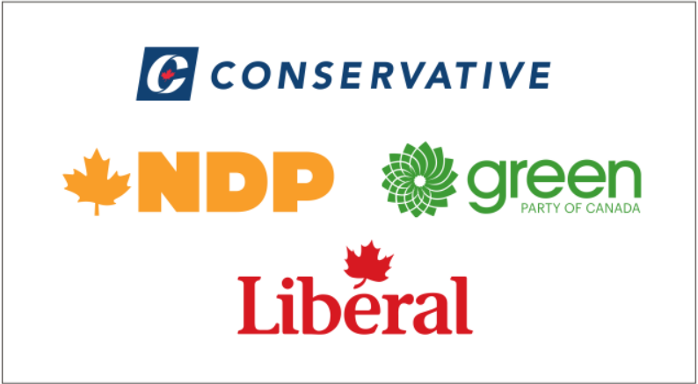
Motivation:-
The final outcome of the project will be very useful to the canadian political parties IT cell. Where a group of political strategists understand the sentiment of the people to develop the parties policies.
Users:-

Slide 4
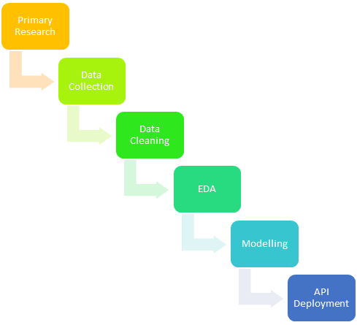
Methodology:-
1
2
3
4
5
6

Slide 5
Primary Research & Data Collection:-
We primarily understood there are 6 major parties in Canada, which are at federal level and also, that are loosely connected to with the parties at the provincial level.
Secondly, candidates tend to use social media to echo the messages as they are highly disciplined in their communications and among them twitter is no exception.
Data Collection Resources:-
Tweepy
Kaggle

Slide 6
Data Collection Stats:-
In order to fetch tweets from twitter, we have requested an elevated twitter developer account, that gives the accessibility to a large number of tweets.
Tweepy package in python is been used to garner our tweets
We collected datasets of 2015, 2019 and 2021 as these are the timelines of elections that happened in Canada, We collected the 2015 and 2019 datasets from Kaggle and used the tweepy package to pull the 2021 data
Keywords:
Year | Tweets | Source
2015 | 3014 | Kaggle
2019 | 2134 | Kaggle
2021 | 6000 | Twitter
#elxn43 OR #cdnpoli OR #ItsOurVote OR #justin OR #justintrudeau OR #lpc OR #liberalparty OR #justin4pm OR #teamtrudeau# OR #liberal OR #liberals OR #voteliberals OR #liberal_party OR #trudeau OR #conservativeparty OR #cpc OR #conservative OR #conservatives OR #votecpc OR #teaparty OR #ndp OR #votendp OR #ndpleader OR #ndpcanada OR #green OR #greenparty OR #gpc OR #canadiangreens OR #greenpartyofcanada OR #votegreen OR #polqc OR #paysqc OR #jevotebloc OR #ppc OR #bloc OR #blocqc OR #greenpeace OR #AndrewScheer OR #Andrew OR #Scheer OR #JagmeetSingh OR #Jagmeet OR #Singh OR OR #people OR ##YvesFrançoisBlanchet OR #Blanchet OR #Yves OR #peopleparty OR #peoplesparty OR #MaximeBernier OR #Maxime OR #Bernier OR #Elizabeth OR #May OR #ElizabethMay OR #leftwing OR #rightwing OR #ItsTimeForYOUToGetAhead OR #Initforyou OR #ChooseForward OR #NotLeftNotRightForwardTogether -filter: retweets

Slide 7

Data Cleaning:-
Removal of punctuations
Removing Mentions
Removing Standalone special characters
Removing emoticons
Removing Retweets
Removing numbers
Removing accented keywords by creating a function
Removing special characters i.e., ^a-zA-z0-9
And cross verifying if we have got any missing values and would that affect our analysis

Slide 8
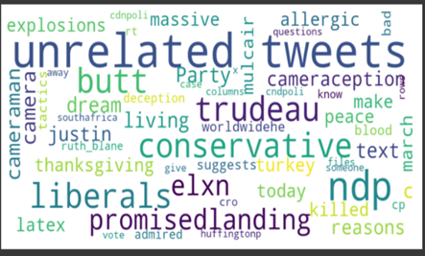
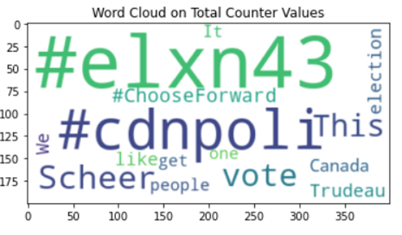
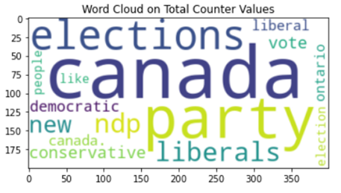
Exploratory Data Analysis:-
2015
2019
2021
#choosefoward was one the top most used hashtags in twitter for the year 2019 which was the election theme for the Liberal Party of Canada.
For the year 2021, most of the political party names are listed which tells us that the year 2022 election was quite tough.

Slide 9
Creating of Labelled Data:-
We have leveraged the TextBlob package in python to create labelled data.
Using Textblob we can find the sentiment polarity of the text based on the words present in it.
Year | Positive Tweets | Negative Tweets | Neutral Tweets
2015 | 19.3% | 9.2% | 71.5%
2019 | 46.6% | 21.9% | 31.5%
2021 | 50.4% | 26.8% | 22.8%

Slide 10
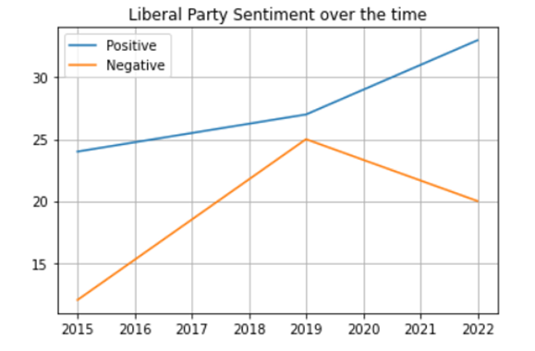
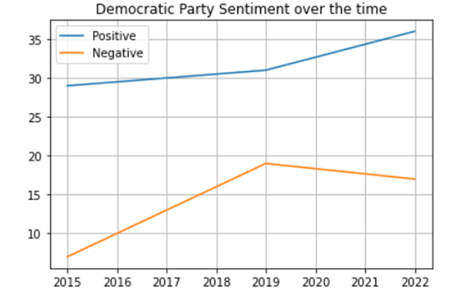
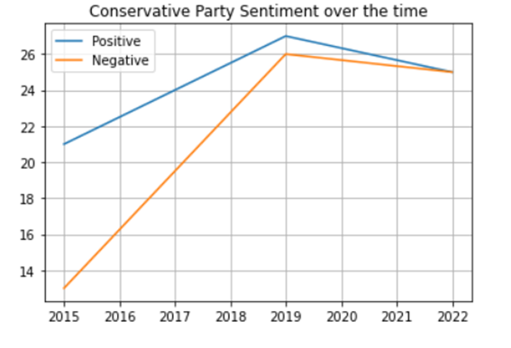
Party Wise Sentiments Over time:-
Liberal party
Democratic party
Conservative party
People’s faith on conservative party is decreased whereas people’s opinion on the Democratic Party and Liberals Party is good as there is a gradual rise in positive and decrease in negative sentiments.

Slide 11
Data Modelling:-
The Project Modelling research has taken in three segments.
Traditional Modelling techniques.
Deep learning techniques.
Transfer Learning.
Vectorization of data was done in three methods.
Count Vectorizer
Traditional Models
Tfidf Vectorizer
Deep Learning Models
Word2Vec
Transfer Learning
Data Loaders

Slide 12
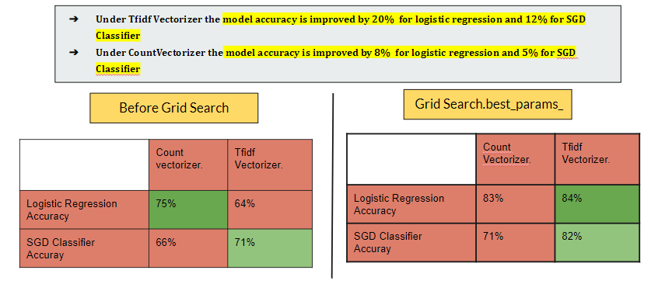
Traditional Models with Grid Search:
We implemented Logistic Regression and SGD Classifier in this segment.

Slide 13
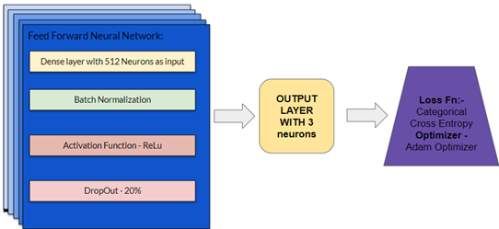
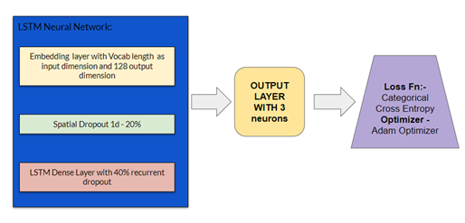
Deep Learning Models:
Deep Learning models were implemented with Word2Vec vectorizer.
Feed Forward Neural Network:
Accuracy:- 56%
LSTM Neural Network:
Accuracy:- 80%

Slide 14
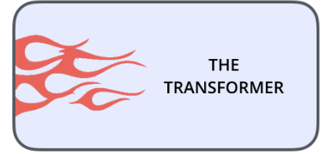

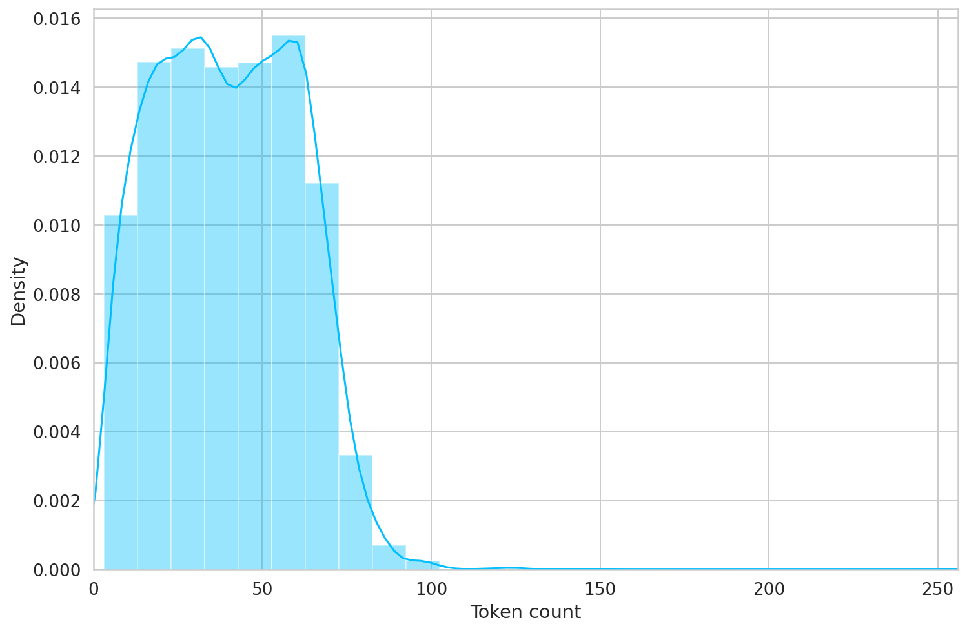
Transfer Learning:
Transformers - This is a python library which gives us the essentials to load and run pretrained models.
BERT - Bidirectional Encoder Representations from Transformers (bert-model-cased)
Count of tokens in each Tweet
120 was the highest count of tokens in each document.

Slide 15
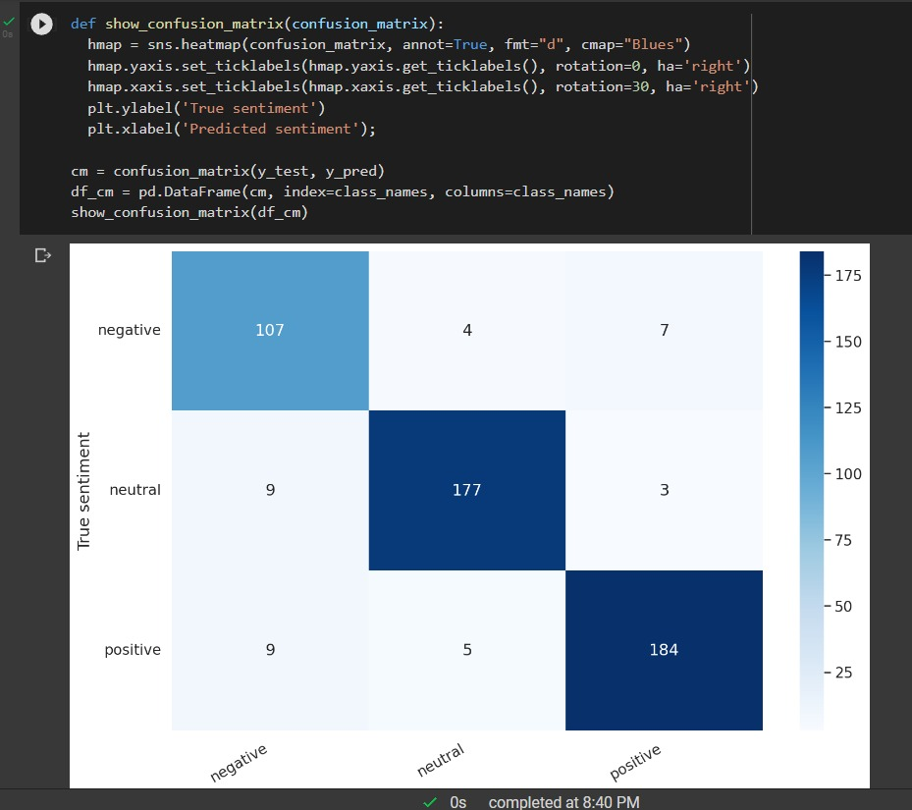
Bert-uncased Performance:-
Accuracy
Train Accuracy - 99%
Val Accuracy - 91%
Test Accuracy - 92%

Slide 16
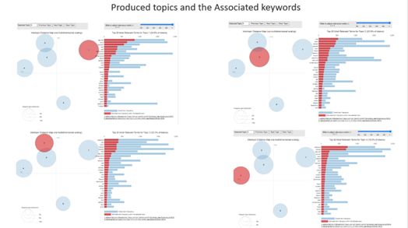
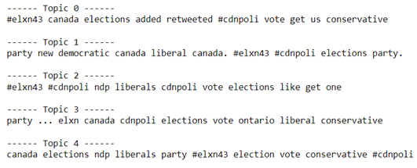
Topic Modelling:-
We have performed topic modelling on the corpus using the LDAmulticore method.
The model was able to capture 5 topics from the corpus.

Slide 17
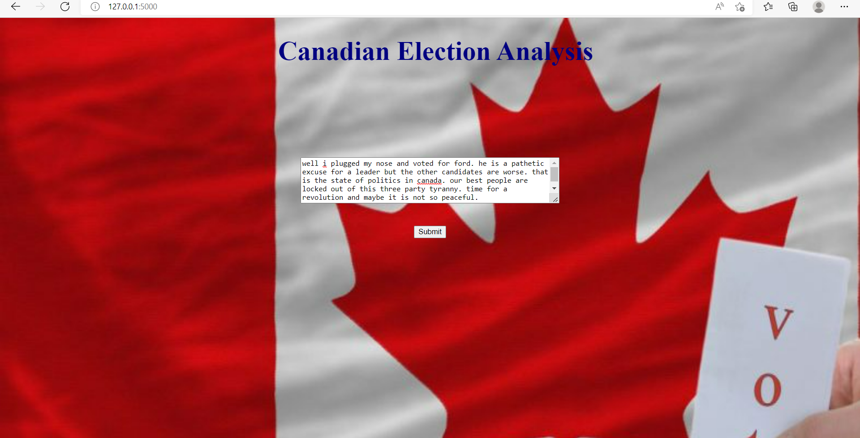
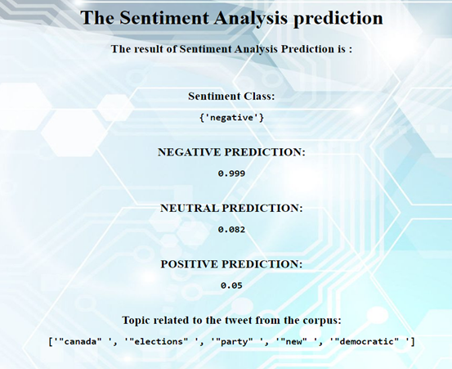
Flask API:-
We have connected our trained model with a Flask API with a route name (‘/get_sentiment()’).
Then we integrated the Flask API with the HTML form.

Slide 18
Future Plans:-
We want to take the project further with the following tasks:
Making Sentiment Analysis on Individual level
Data Collection - Collect Data from other media Sources - Facebook, Reddit etc.
Modelling - Implementation of the other Transfer learning models.
UI - Develop a Interactive UI by adding the Tableau Dashboards.

Slide 19
References:
[1] Beck, M. (2020). How to Scrape Tweets From Twitter. towardsdatascience.
[2] David W. Nickerson, T. R. (2013). Political Campaigns and Big . Harvard Kennedy School.
[3] T, S. K. (2021). Natural Language Processing – Sentiment Analysis using LSTM. Analytics vidhya.
[4] Therriault, A. (2016). Data and Democracy. O'Reilly Media, Inc.
[5] Venelin. (2020). Sentiment Analysis with BERT and Transformers by Hugging Face using PyTorch and Python. curiousily.
[6] Yiu, T. (2019). Understanding NLP and Topic Modeling Part 1. kdnuggets.

Slide 20
ANY QUESTIONS?

